Slide 1
P&L 2024 Jan-Sep
K1 Technology
Presented By Edgar Borja. Oct-11-2024

Slide 2
2024 Summary
Q1: We invested in facilities and equipment. Early sales were promising, but product refinements were necessary to address reported issues.
Q2: Focused on R&D to enhance the product. We completed a full software rebuild and updated the hardware, significantly improving QR code reading. We will offer the new software to all past customers at no cost.
Q3: Launched the updated machines, receiving positive market feedback. In September, we secured our largest single order to date, with 10 units sold to a customer in South Africa.
Q4: Currently working on securing an order from El Salvador’s National Bank (Banco Hipotecario), which could pave the way for collaborations with other regional banks. Participation in the Adopting Bitcoin Conference is expected to further drive sales. Our focus has now shifted to Sales and Marketing.
Our seed round successfully closed with $150k from FGW, alongside an additional $110k from a returning customer eager to invest. This funding secures our operations through 2025.

Slide 3
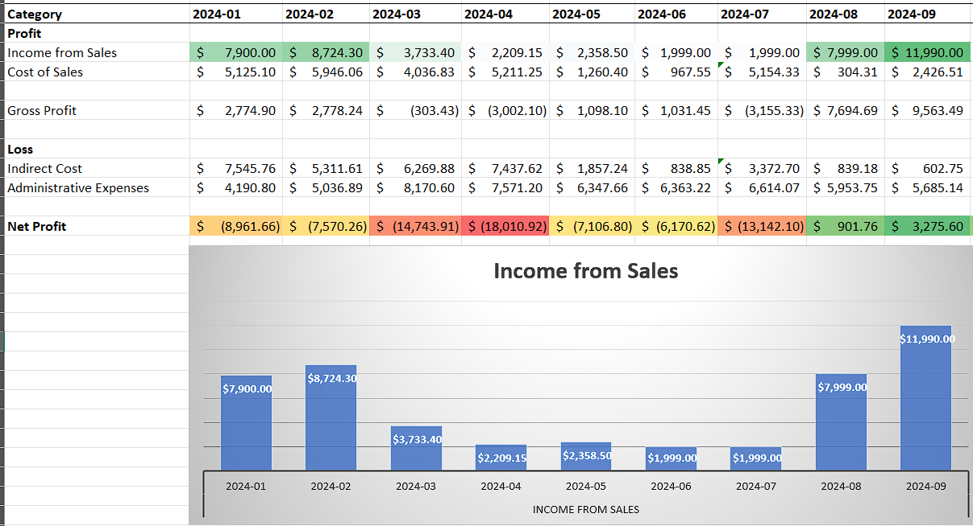
2024 P&L (preliminary)

